Slide 1


Slide 2
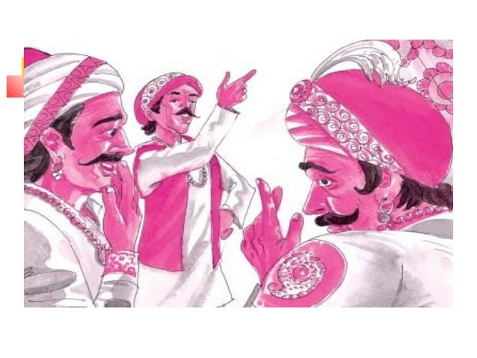
INTRODUCTION
“In the Kingdom of Fools” is a folktale that brings to light the dangers posed by foolish people. It also emphasizes the view that foolish people can be very difficult to manage. They can be dealt with only by the wise and calm people.

Slide 3
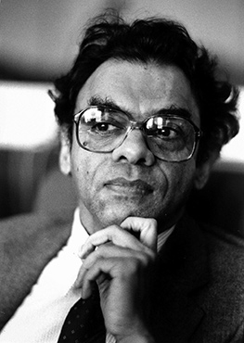
ABOUT THE AUTHOR
A.K. Ramanujan is indeed one of the prominent figures associated with the English translation of "The Kingdom of Fools."
A.K. Ramanujan (1929–1993) was a renowned Indian poet, scholar, and translator. He is well-known for his translations of Indian folklore, classical poetry, and tales from a variety of regional languages. Ramanujan's work brought traditional Indian literature to a global audience through his sensitive and nuanced translations.

Slide 4
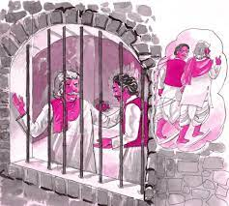
ABOUT THE STORY
"The Kingdom of Fools" is a humorous and thought-provoking story from the Panchatantra, a collection of ancient Indian fables. In this story, the absurdity of a kingdom ruled by foolish leaders and citizens leads to a series of comical and surprising events. It is often used to teach moral lessons about the consequences of ignorance and irrational decision-making.

Slide 5
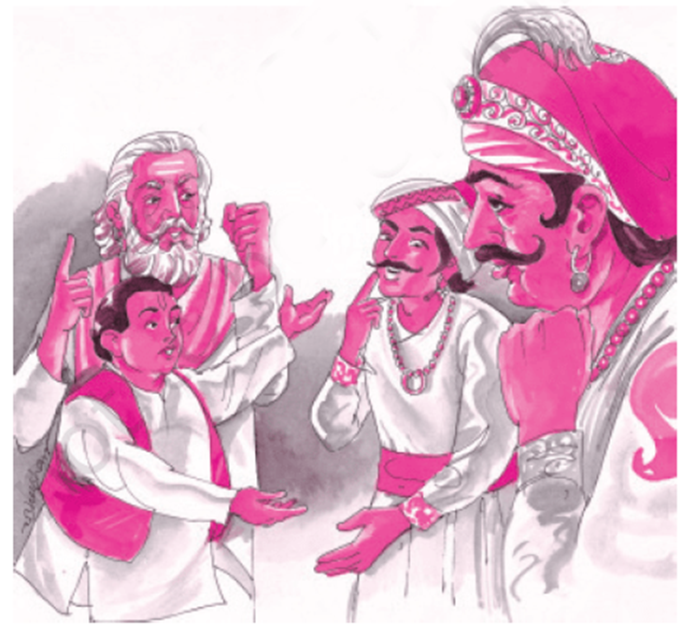
MORAL OF THE STORY
The Consequences of Foolish Leadership: The story teaches that when leaders and decision-makers act without wisdom or reason, they create chaos and confusion for everyone.
The Importance of Wisdom and Common Sense: It emphasizes that wisdom, logic, and common sense should guide decisions, especially in leadership and governance. The absurdity of the kingdom serves as a cautionary tale for those in power.
The Power of Cleverness: The story also highlights how wit and intelligence can bring clarity and resolution to even the most irrational situations.

Slide 6
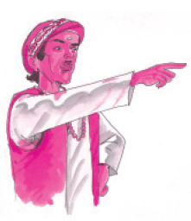
SUMMARY OF THE STORY
Once, a foolish king ruled a kingdom where logic was ignored, and absurd laws were enforced. Day became night, and people worked at odd hours, causing chaos. One day, a clever traveler arrived and saw the disorder. When a crime was committed, the king’s foolish laws led to the wrongful punishment of an innocent person. Using wit and intelligence, the traveler cleverly outsmarted the system, teaching the people that wisdom and common sense should guide their lives. The story highlights the dangers of foolish leadership and the power of cleverness.

Slide 7


Slide 8

OUR TEAM MEMBERS
SANJITH RAM
HARI
KAASI
NATHUL
KIRUTHICK PRANAV
RUDHERSH
PAVAN BALA
SURYA

